Slide 1

ENHANCEMENTS AND REAL-WORLD APPLICATIONS OF POINT-TO-POINT PROTOCOL:
A COMPARATIVE ANALYSIS OF PPP AND PPPOE IN WAN CONNECTIVITY
MADRINAN, TAN, GUTIERREZ

Slide 2








PROBLEM STATEMENT AND OPPORTUNITIES
Context of the problem:
The Point-to-Point Protocol (PPP) and its successor, Point-to-Point Protocol over Ethernet (PPPoE), are important to networking but are rarely directly compared in a modern context
Most existing studies focus on individual aspects of PPP or PPPoE without a comprehensive comparison of their technical enhancements, Quality of Service (QoS), and scalability.

Slide 3
PROBLEM STATEMENT AND OPPORTUNITIES
Opportunities:
Provide ISPs with insights into protocol selection and optimization for broadband and multi-user networks.
Serve as a foundational resource for students and professionals in networking education.
Support organizations transitioning from legacy PPP systems to scalable PPPoE solutions.

Slide 4









Technical Enhancements
To evaluate the technical enhancements in PPPoE compared to PPP, focusing on aspects like authentication, encapsulation, and session management.
Quality of Service
To compare the Quality of Service (QoS) capabilities of PPP and PPPoE in traffic prioritization, bandwidth allocation, and latency management.
Scalability
To assess the scalability of both protocols in supporting modern networking environments, such as broadband and multi-user systems.
OBJECTIVES
This study seeks to address the following objectives:

Slide 5










SCOPE
Secondary Data
Focuses on secondary data from RFCs, technical guides, and academic literature to compare PPP and PPPoE.
Parameters
Technical Enhancements, QoS, and Scalability only
No Simulation
Does not include empirical testing or simulations but emphasizes theoretical and practical insights from existing research.

Slide 6
REVIEW OF RELATED LITERATURE
Key Research Areas
Historical Background of PPP and PPPoE
Point-to-Point Protocol (PPP)
Introduced in RFC 1134 (1989) and RFC 1661 (1994)
Designed for point-to-point serial connections
Features include authentication, encapsulation, and error checking.
Point-to-Point Protocol over Ethernet (PPPoE)
Introduced in RFC 2516 (1999).
Built to support Ethernet networks and broadband scalability.
Enhancements include session management, and dynamic IP allocation.

Slide 7
REVIEW OF RELATED LITERATURE
Key Research Areas
Enhancements and Technical Modifications
Quality of Service (QoS) in PPPoE
Real-World Applications and Scalability
PPP: Designed for single-user connections, limited scalability
PPPoE: Adds session-based architecture, supports shared Ethernet environments, improves authentication processes.
PPP: Lacks native QoS mechanisms.
PPPoE: Implements QoS features like traffic prioritization (DiffServ, Ethernet 802.1p)
PPP: Found in legacy systems, point-to-point leased lines, and VPNs.
PPPoE: Widely used in DSL and FTTH networks for session-based user management

Slide 8
METHODOLOGY
Comparative Analysis: Summarized Findings
Table: Technical Enhancements
Aspect | PPP | PPPoE
Authentication | Supports PAP/CHAP for basic authentication | Same with PPP but w/ session-based architecture
Encapsulation | For point-to-point links; limited flexibility | Adapted for Ethernet, enables shared networks
Session Management | None: single-user only | Allows multiple users on shared Ethernet

Slide 9
METHODOLOGY
Comparative Analysis: Summarized Findings
Table: Quality of Service (QoS)
Aspect | PPP | PPPoE
Traffic Prioritization | No native QoS support | Uses DiffServ and 802.1p for traffic prioritization
Bandwidth Allocation | No built-in mechanism; relies on external tools | Supports traffic shaping and bandwidth control
Latency Management | Lacks direct support for latency and jitter | Minimizes latency/jitter for VoIP, streaming, and gaming

Slide 10
METHODOLOGY
Comparative Analysis: Summarized Findings
Table: Scalability
Aspect | PPP | PPPoE
Connection Type | Single-user, point-to-point connections | Multiple sessions over shared Ethernet
IP Addressing | Static/manual IP; not scalable for large user bases | Dynamic IP allocation for each session
ISP Deployment | Rarely used in modern ISP setups | Widely adopted for broadband services

Slide 11
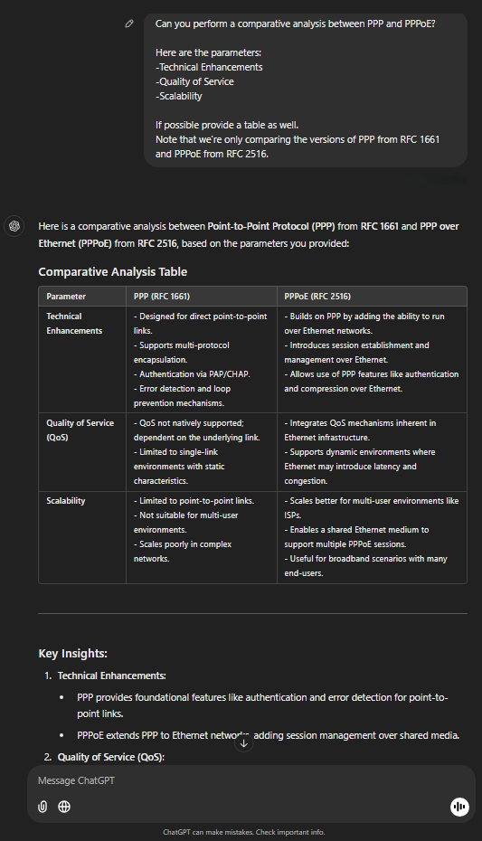
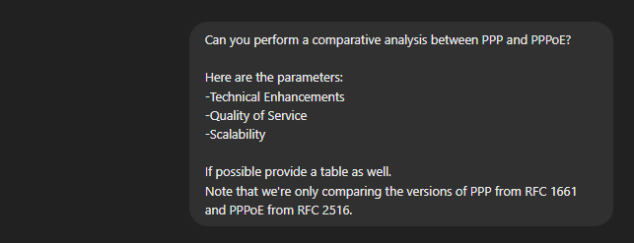
Comparison of Results:
Our Study vs ChatGPT output
Overview of AI Output
Full conversation:
User prompt:

Slide 12
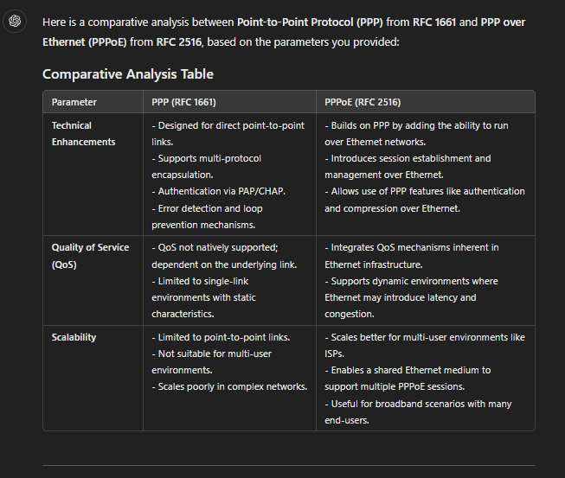
GPT Response Part 1:

Slide 13
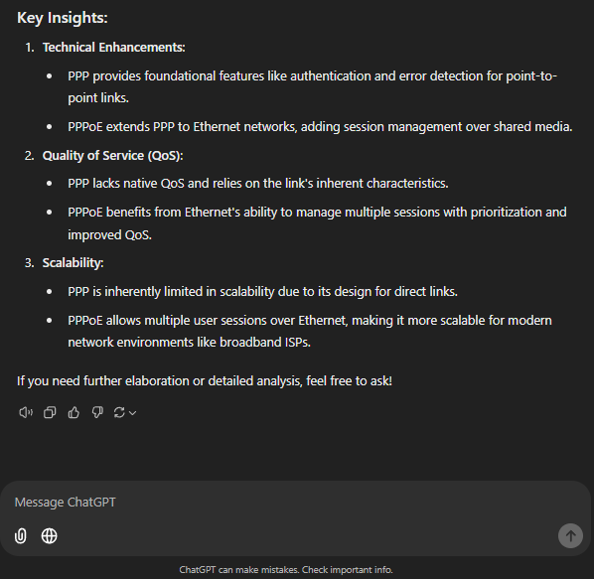
GPT Response Part 2:

Slide 14
Comparison of Results:
Our Study vs ChatGPT output
Comparison of Results: Summary
Aspect | AI Output | Verdict
Technical Enhancements | Mentions Ethernet compatibility and session establishment. | Correct but lacks details on encapsulation flexibility and multi-user scalability.
Quality of Service | Notes QoS in PPPoE but doesn’t specify mechanisms. | Partially correct; misses details on DiffServ, 802.1p, and latency management.
Scalability | Highlights PPPoE’s scalability for ISPs. | Correct but overlooks PPP’s static design limitations and real-world examples of PPPoE’s use cases.

Slide 15
CONCLUSION
Findings:
PPPoE builds on PPP by introducing session-based management and Ethernet encapsulation, addressing PPP’s scalability and multi-user limitations
PPPoE integrates QoS mechanisms like DiffServ and 802.1p, implies better traffic prioritization and latency management, unlike PPP.
PPPoE’s scalability through dynamic IP allocation makes it necessary for ISP’s, while PPP remains relevant in legacy applications.
This study provides insights valuable for ISPs optimizing their network protocols, and organizations transitioning from legacy systems.
Our findings emphasize the evolution of networking protocols and their continued importance in modern systems, reinforcing the value of human-led research over generalized AI outputs."

Slide 16
Questions & Answers

